Slide 1
THREE4CLIMATE WORKING-LEVEL KICK-OFF
City & School Presentations

Slide 2
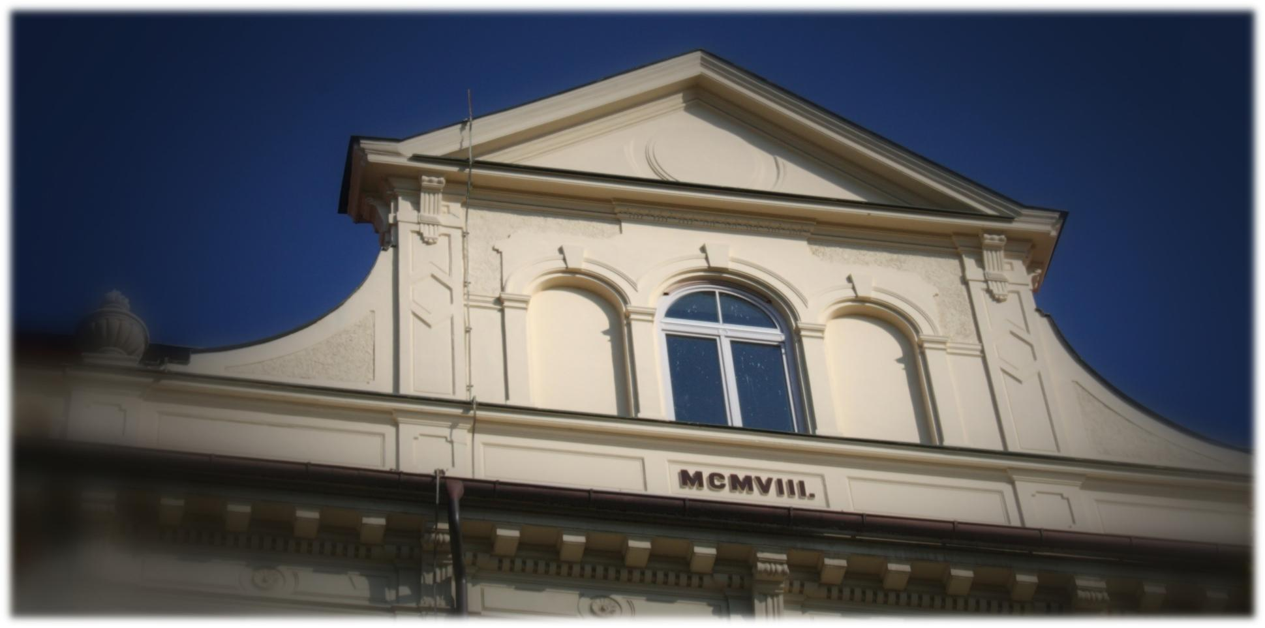
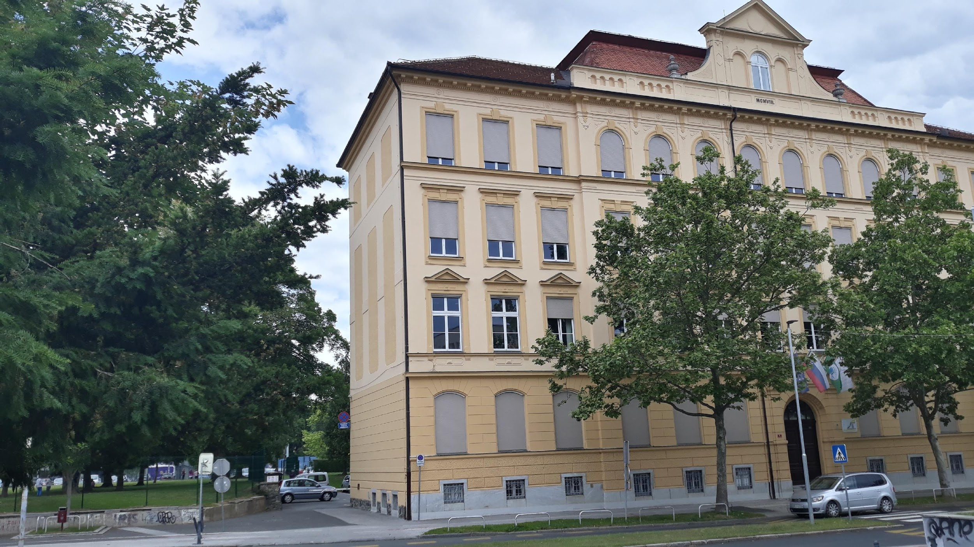
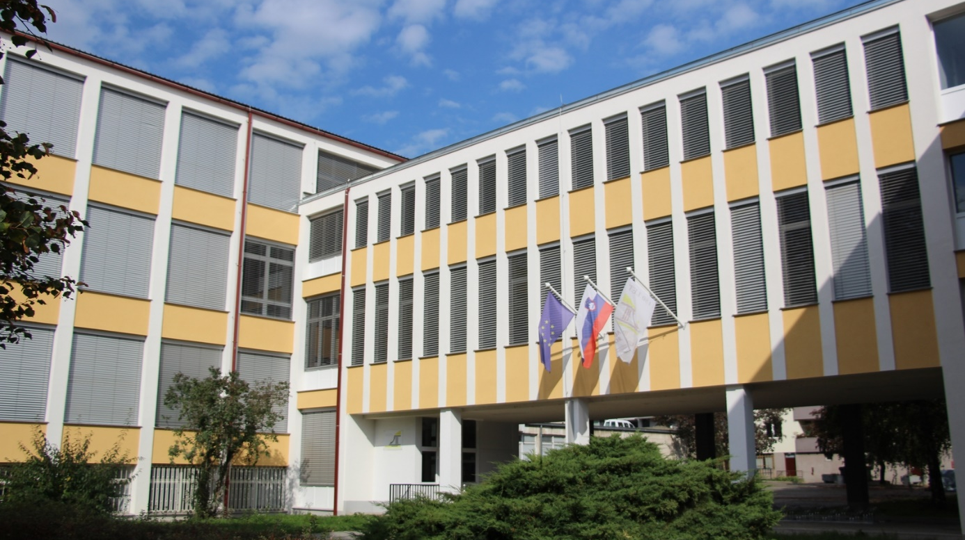
III. GIMNAZIJA MARIBOR (Maribor, Slovenia)
Non scholae, sed vitae discimus.
"Not for school, for life we learn."
There are around 850 students, aged from 15 to 18, and 70 teachers in our school.
It is a secondary school.

Slide 3
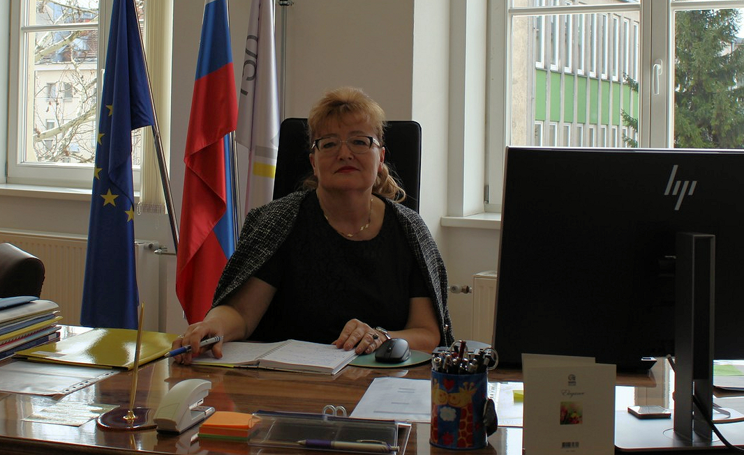
III. GIMNAZIJA MARIBOR (Maribor, Slovenia)
Non scholae, sed vitae discimus.
"Not for school, for life we learn."
Our headmistress Marija Lešer

Slide 4
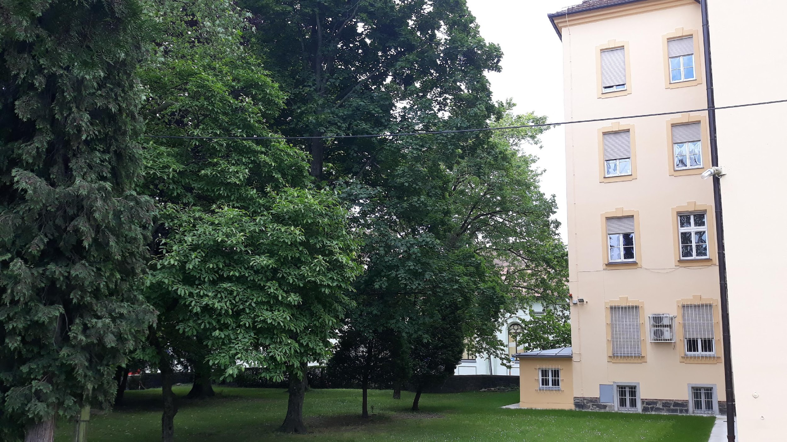
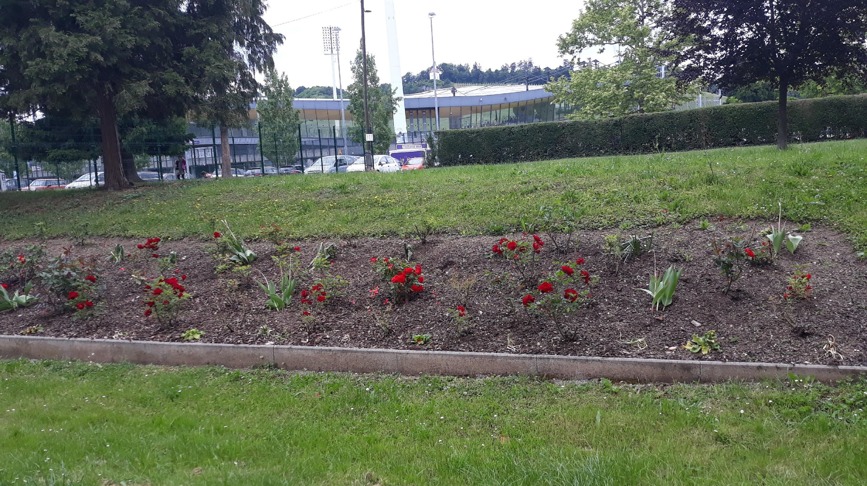
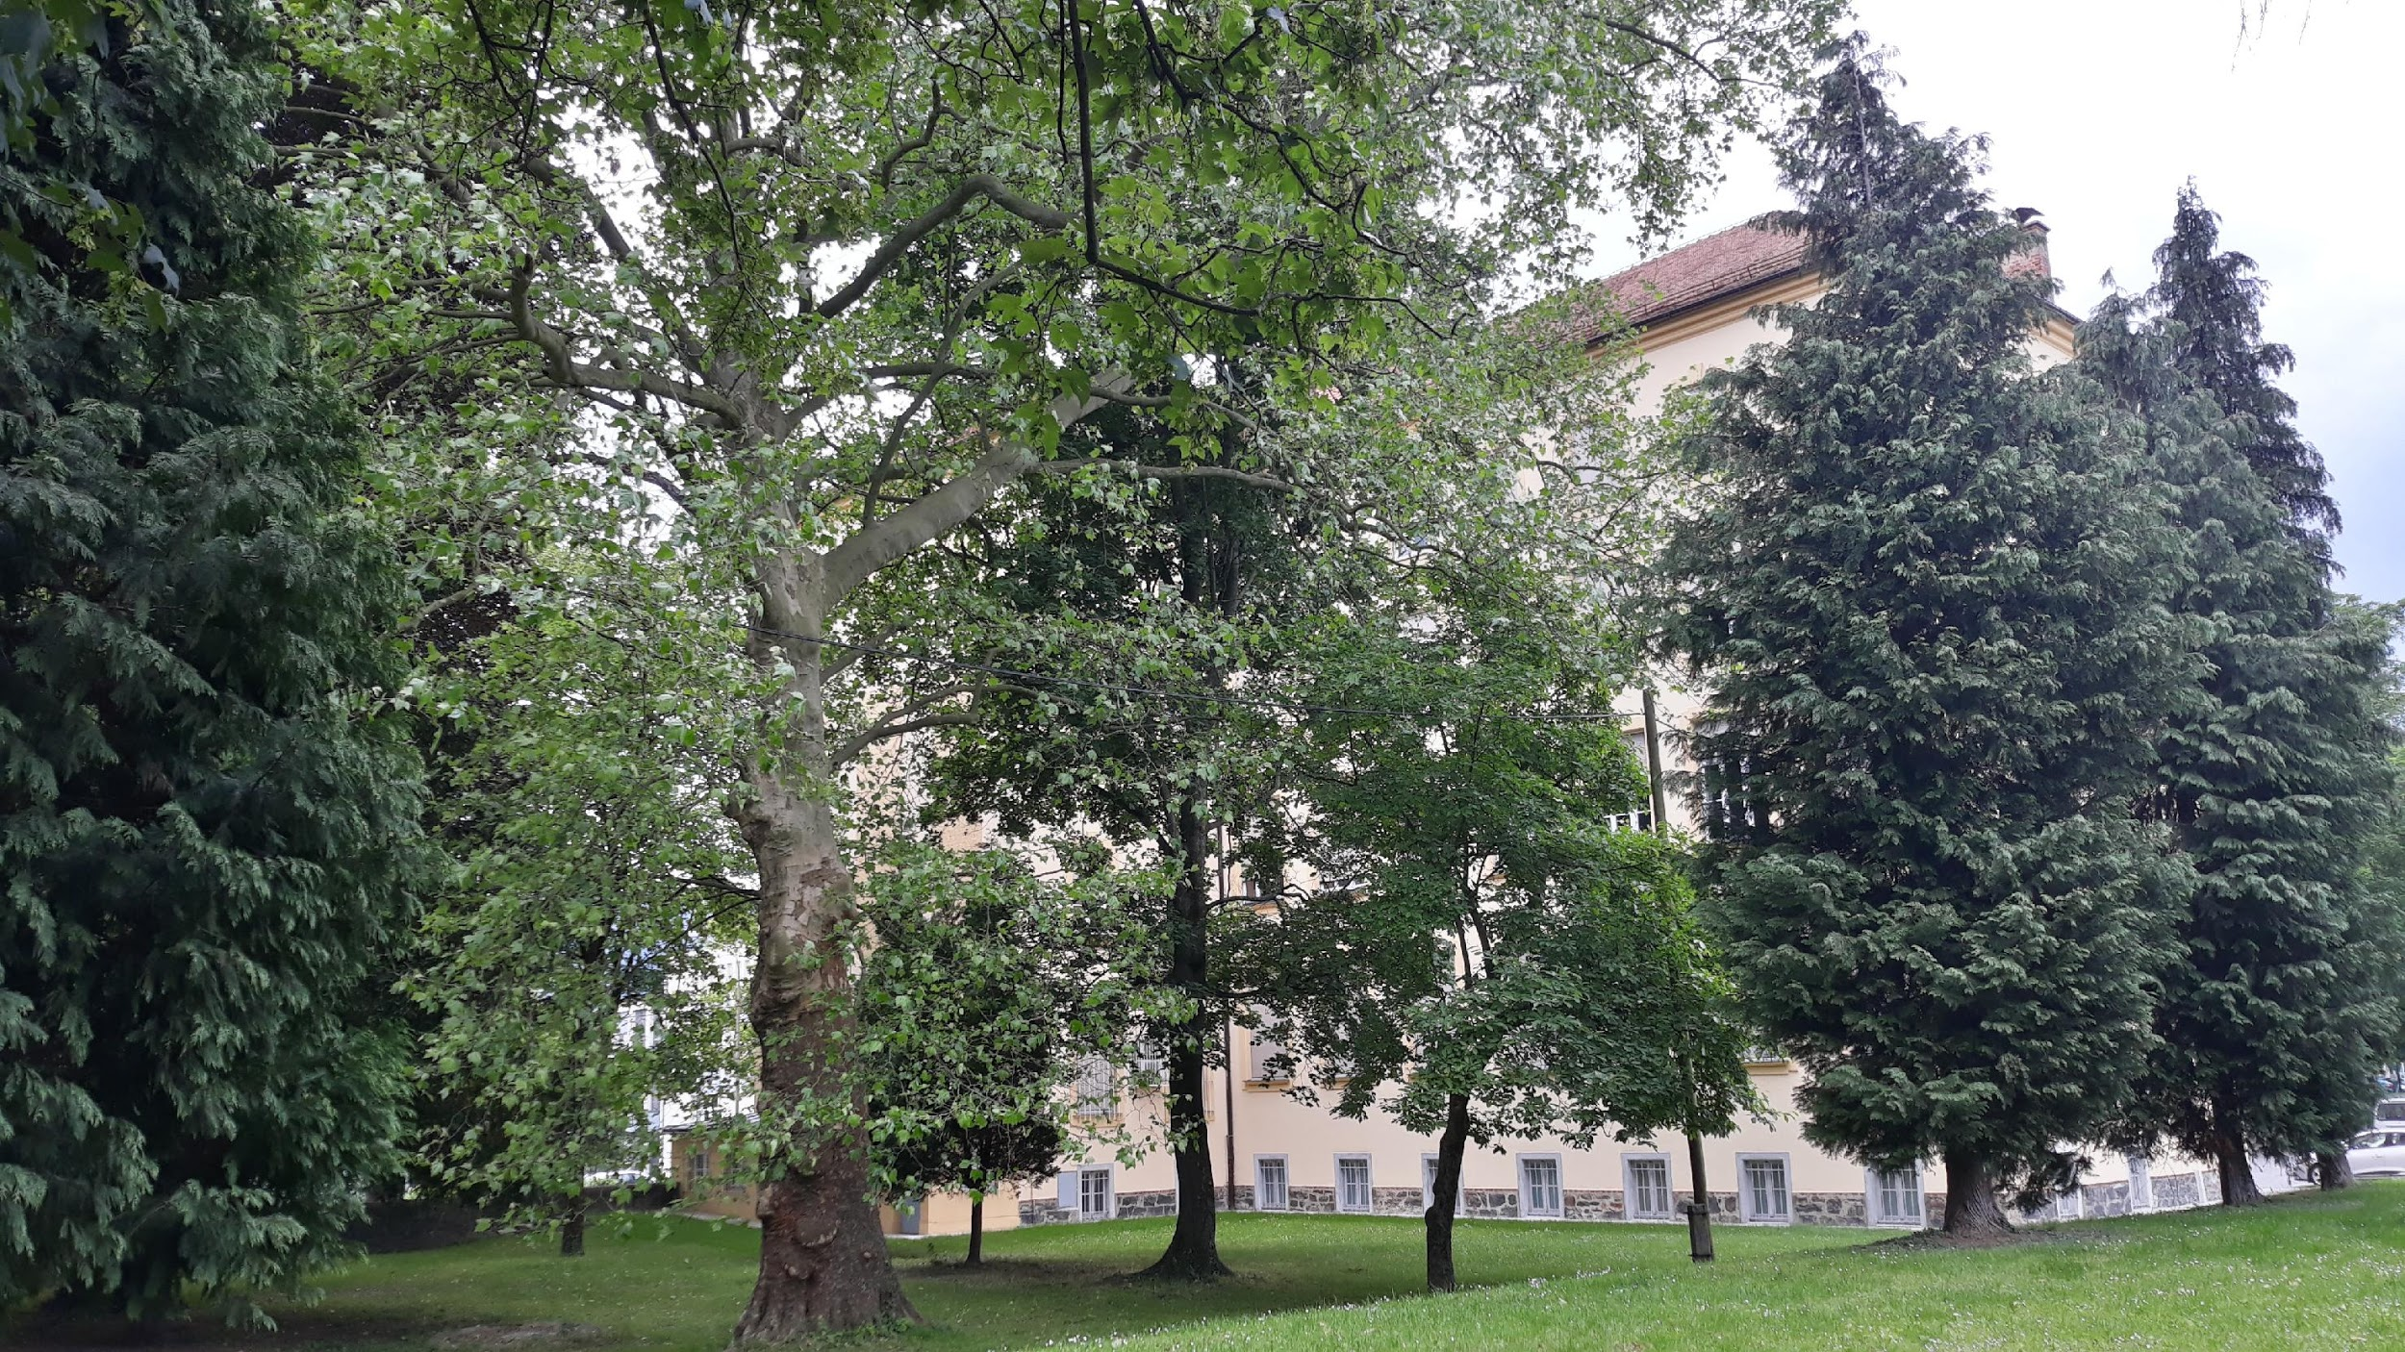
III. GIMNAZIJA MARIBOR (Maribor, Slovenia)
Non scholae, sed vitae discimus.
"Not for school, for life we learn."
Our school building is situated next to a beautiful park, filled with amazing, tall trees.

Slide 5
III. GIMNAZIJA MARIBOR (Maribor, Slovenia)
Non scholae, sed vitae discimus.
"Not for school, for life we learn."
The school has a 157-year tradition.

Slide 6
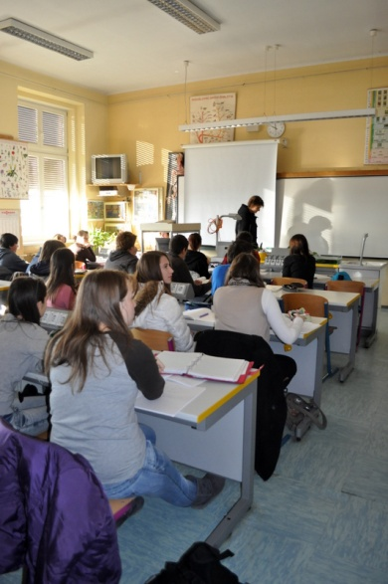
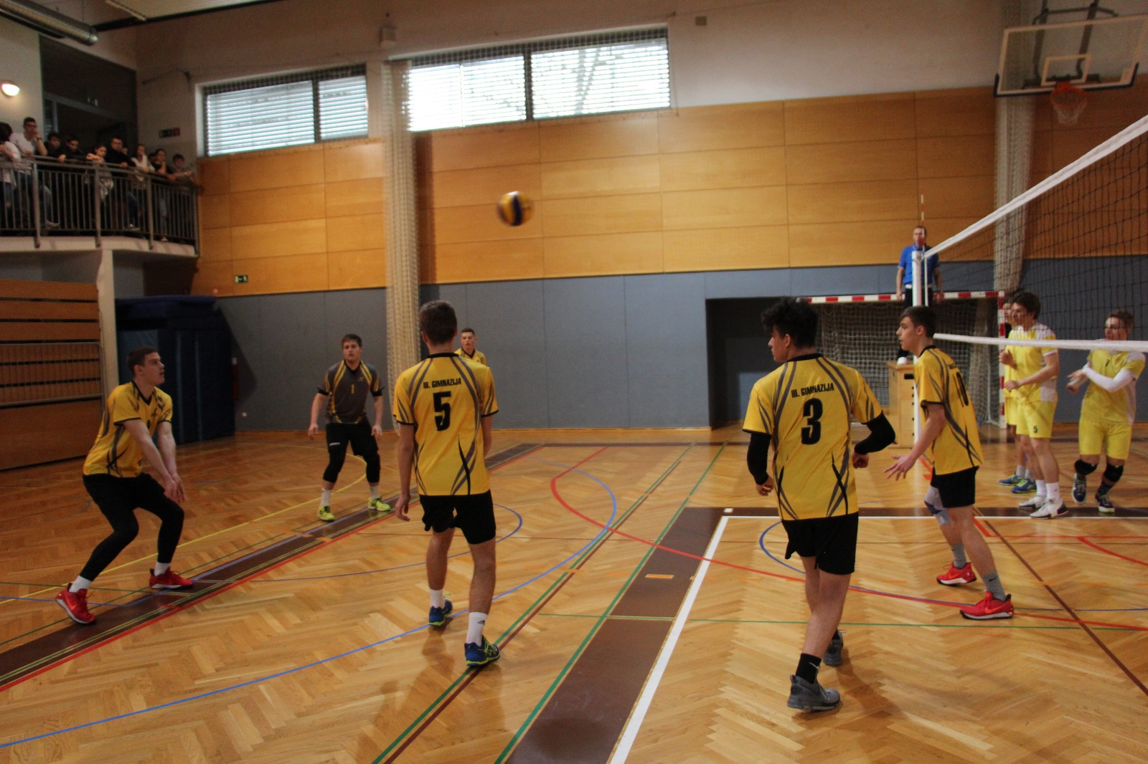
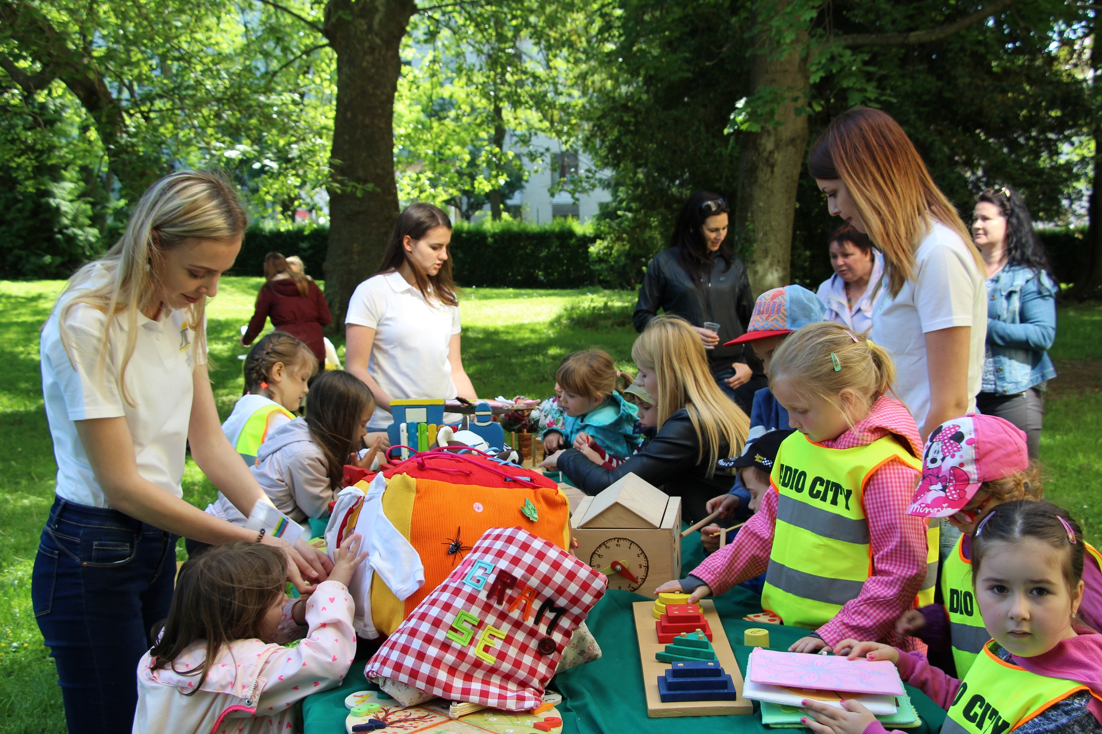
III. GIMNAZIJA MARIBOR (Maribor, Slovenia)
Non scholae, sed vitae discimus.
"Not for school, for life we learn."
There are three educational programs:
Gymnasium (grammar school),
Sport Classes,
Preschool education.

Slide 7
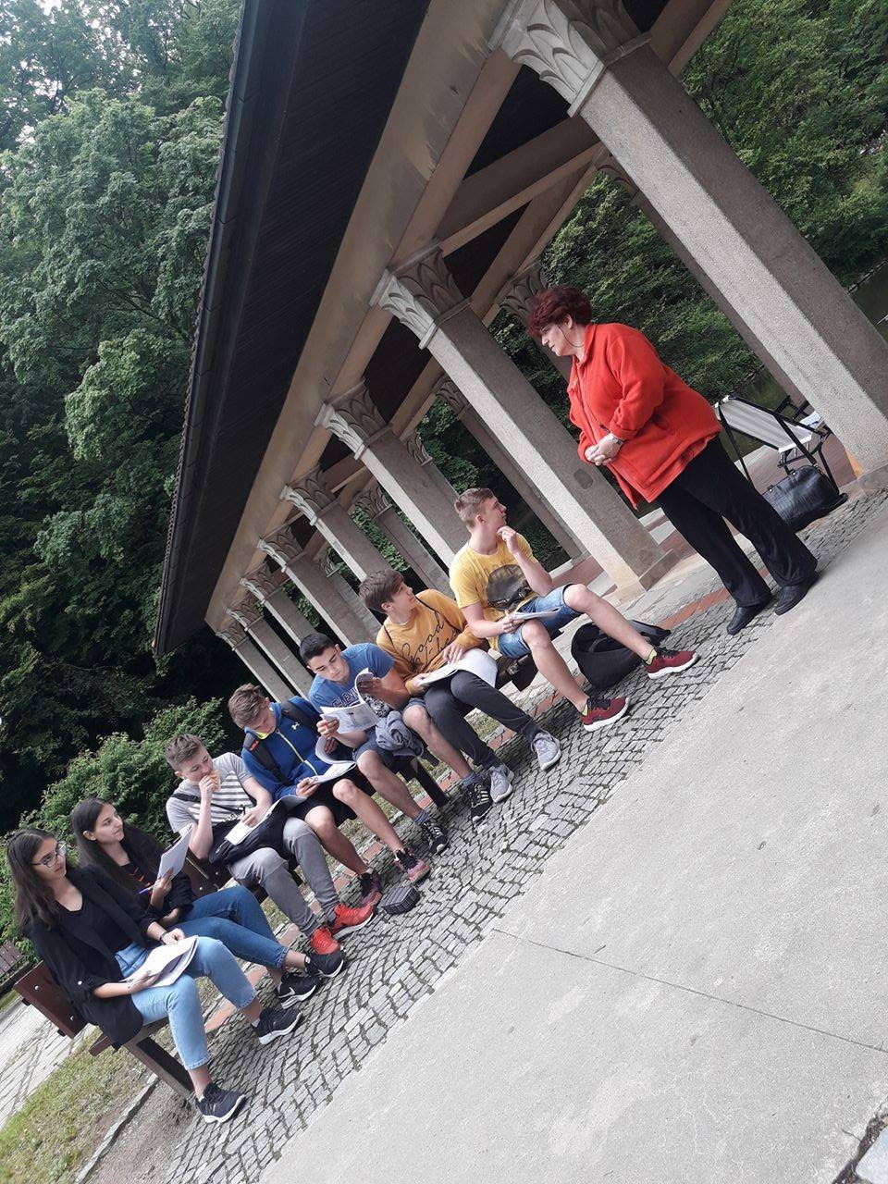
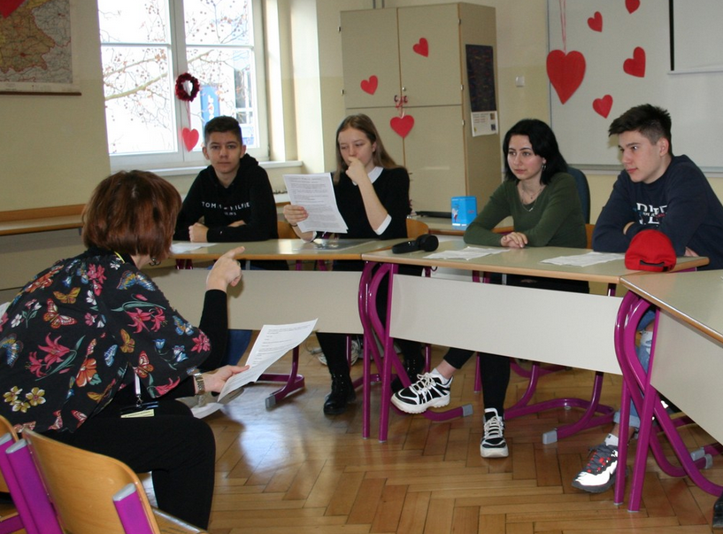
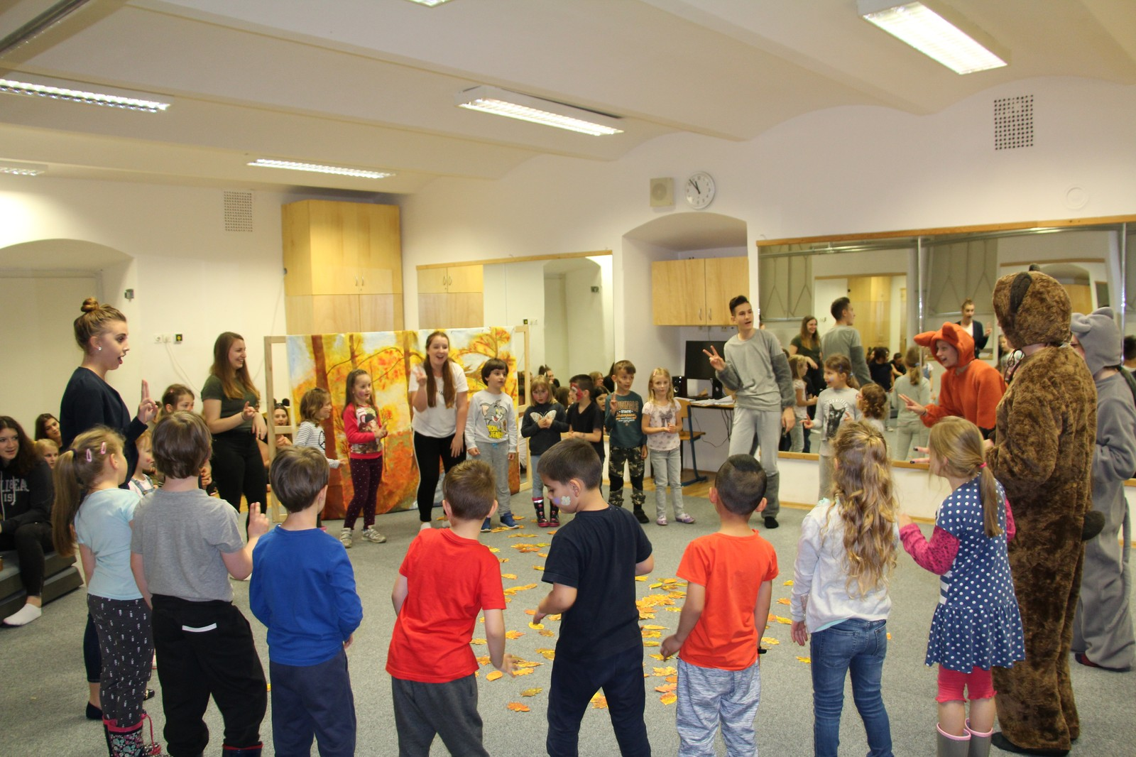
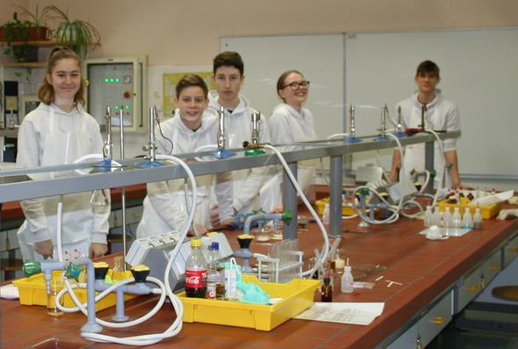
III. GIMNAZIJA MARIBOR (Maribor, Slovenia)
Non scholae, sed vitae discimus.
"Not for school, for life we learn."
The school fulfils its mission through developing responsibility, support, innovation and creativity.

Slide 8
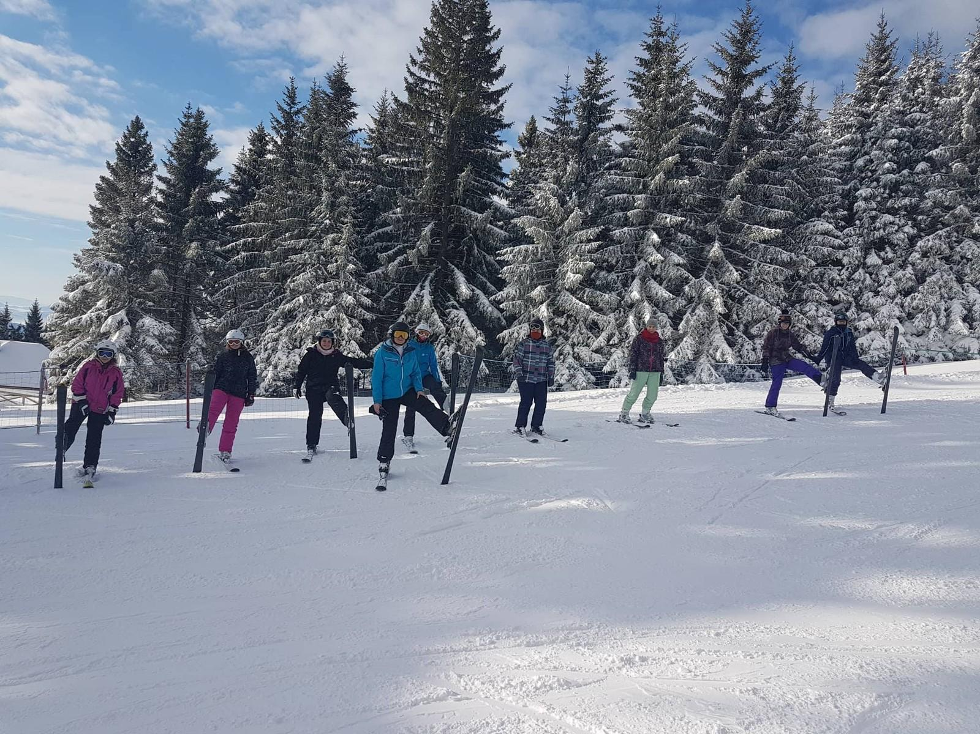
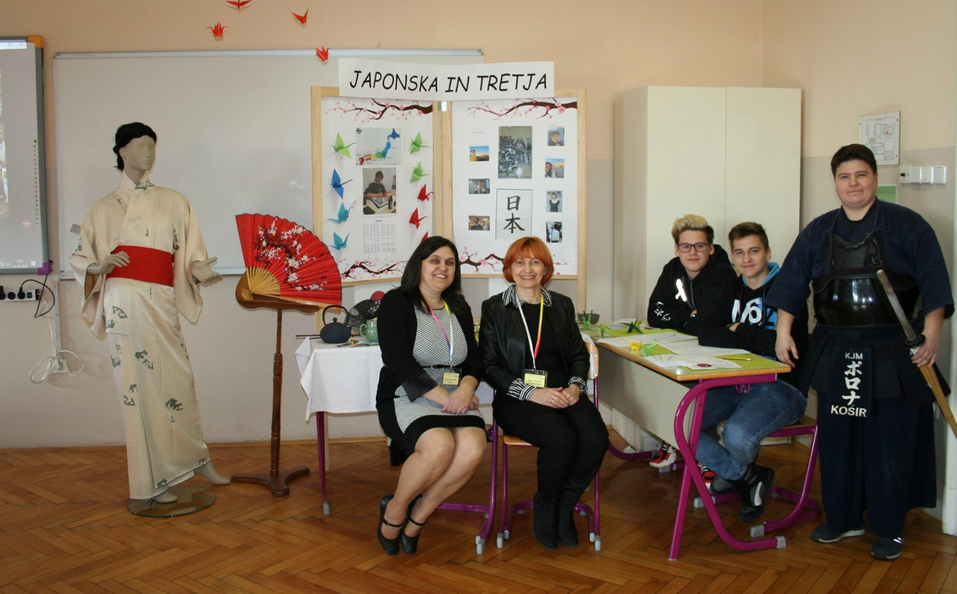
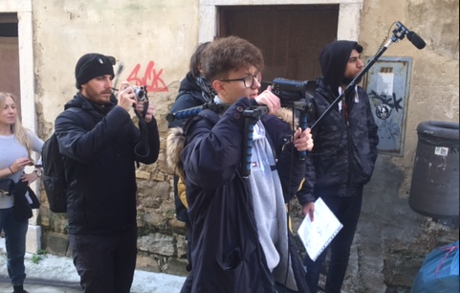
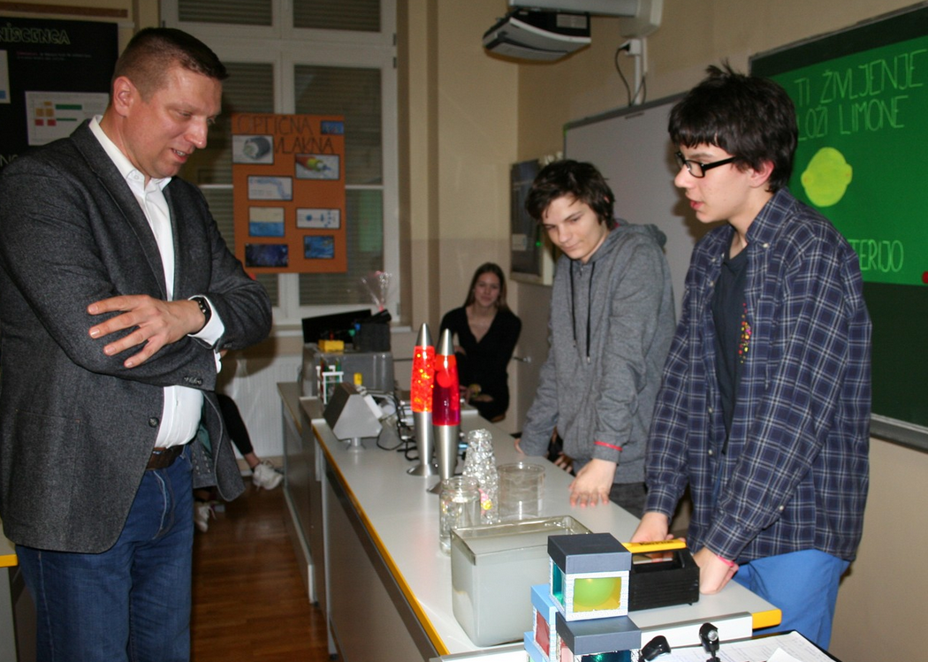
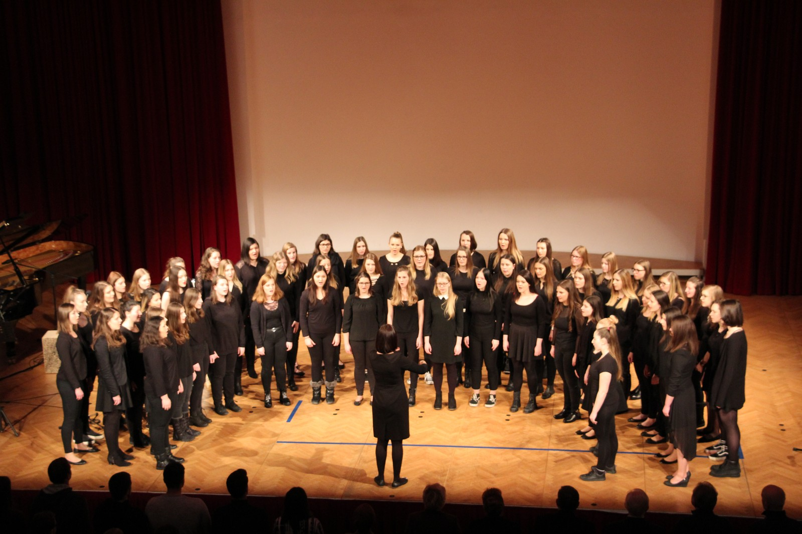
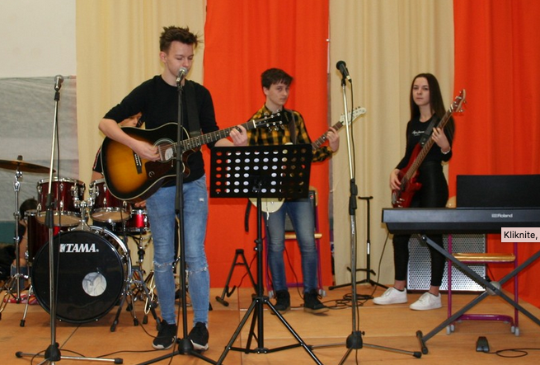
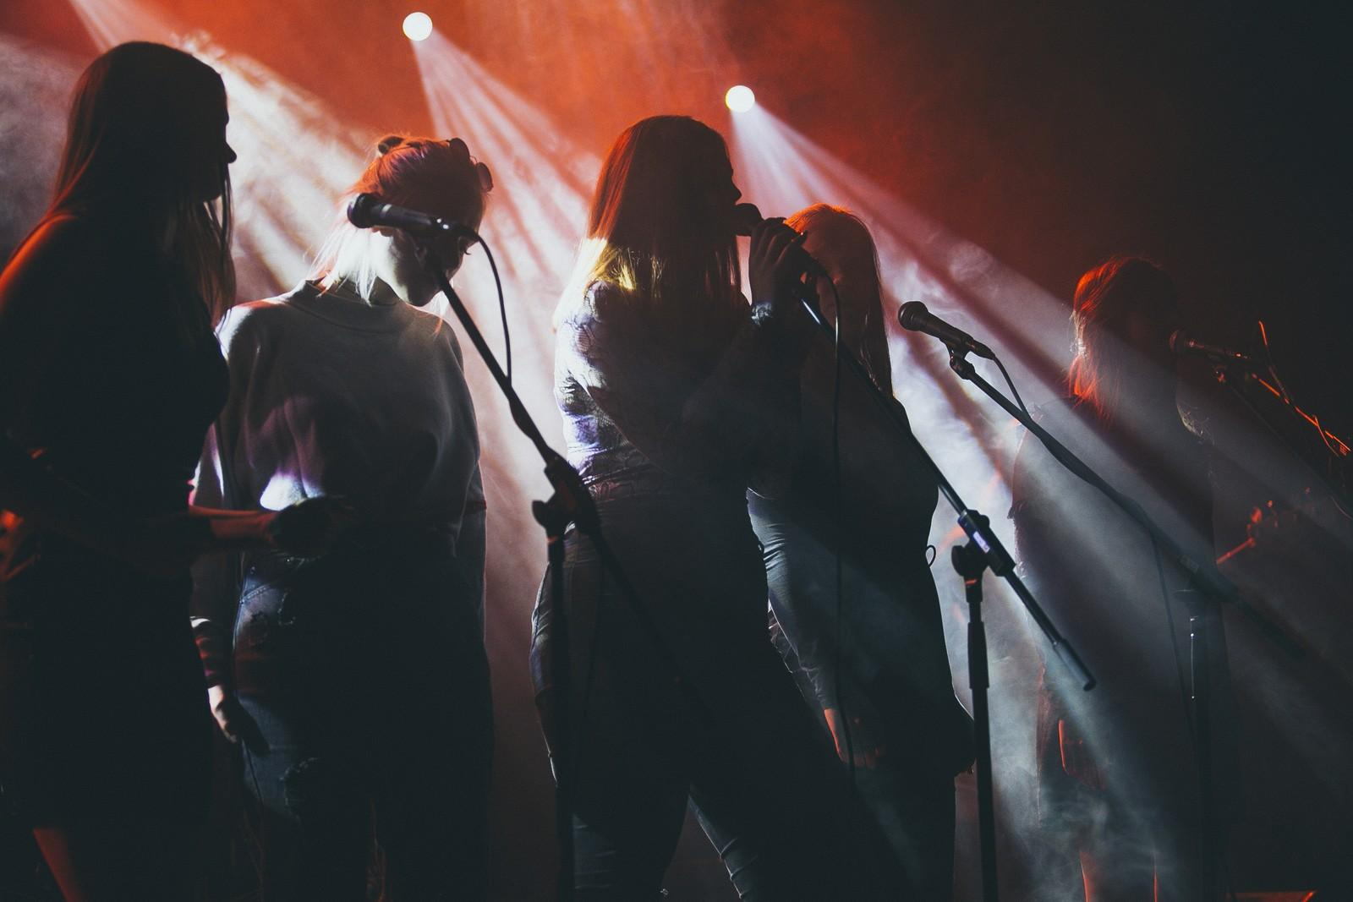
III. GIMNAZIJA MARIBOR (Maribor, Slovenia)
Non scholae, sed vitae discimus.
"Not for school, for life we learn."
Our students also take part in:
Extracurricular activities
Exchange programmes
Projects

Slide 9
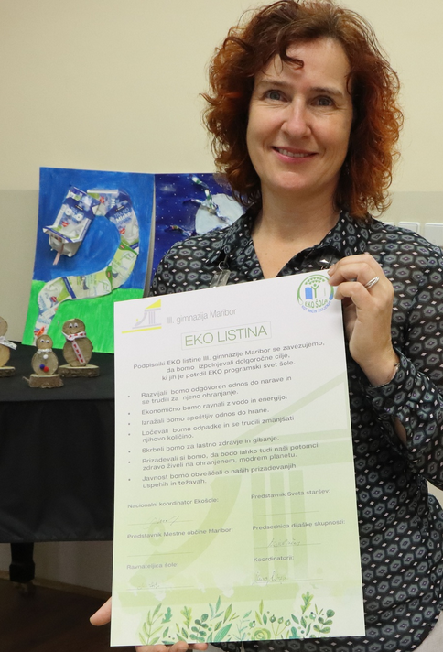
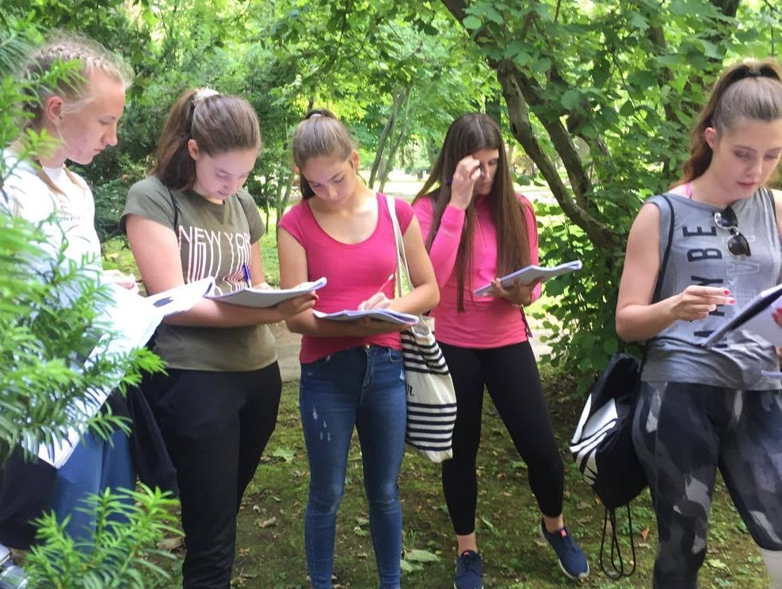
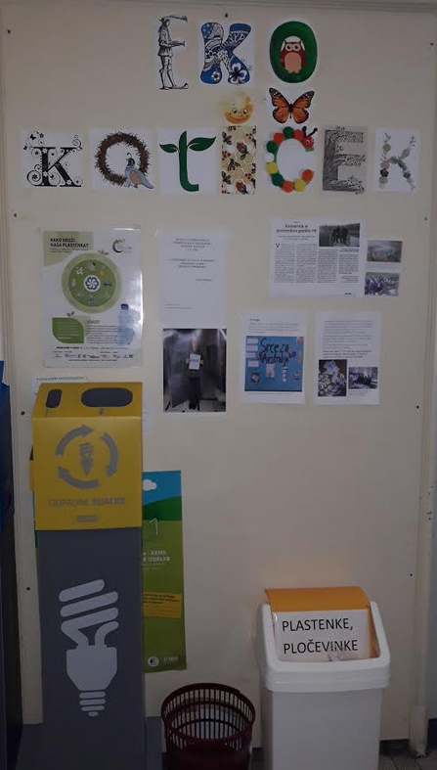
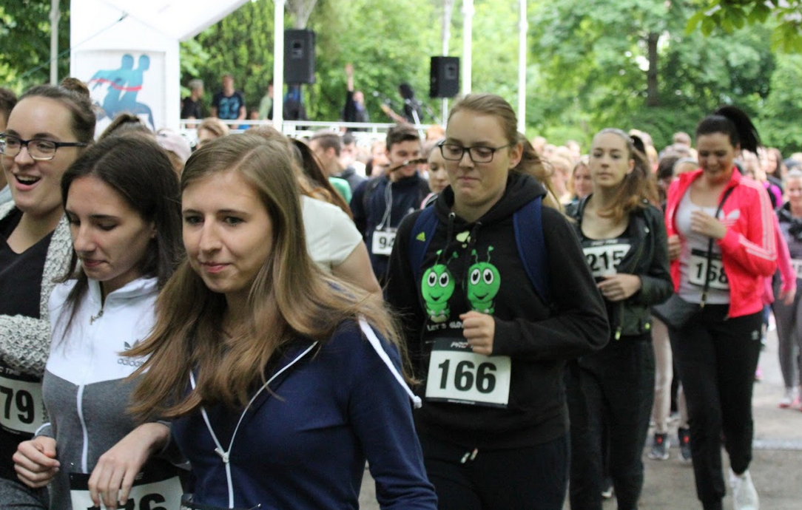
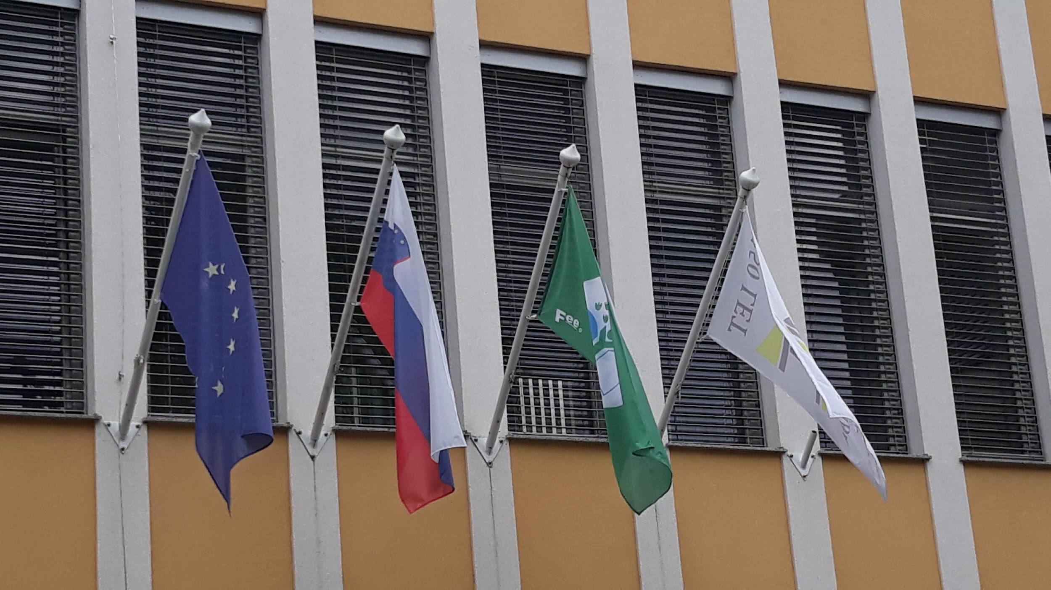
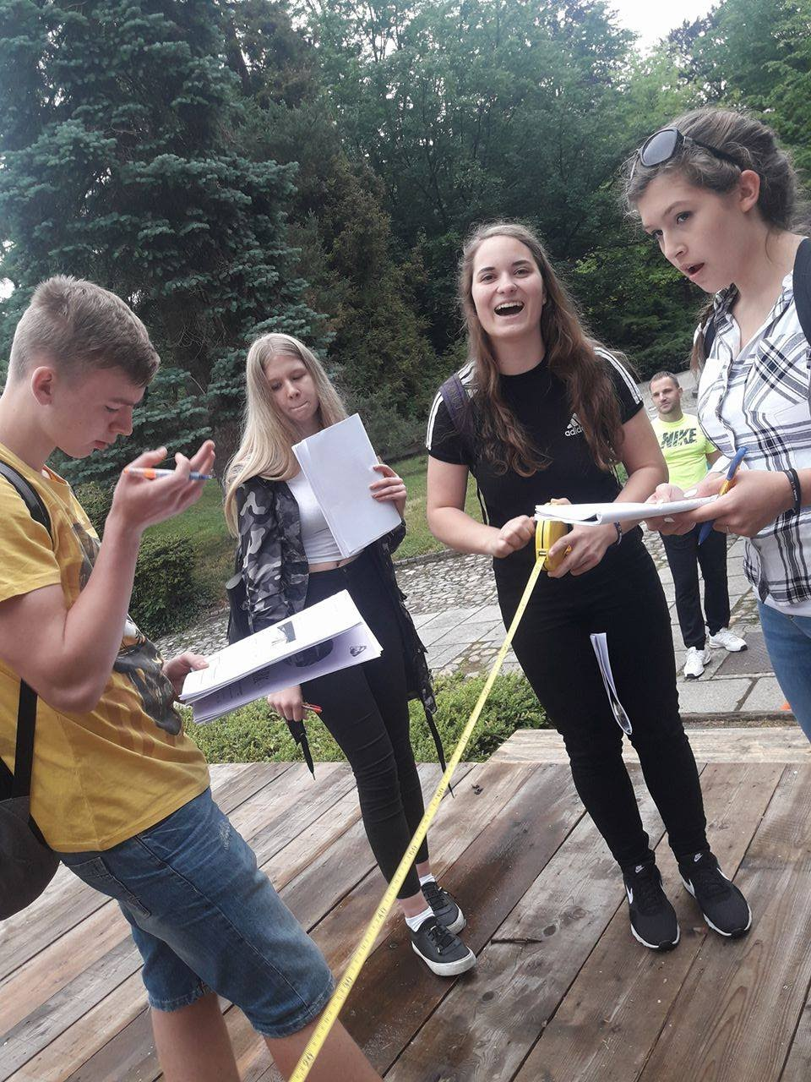
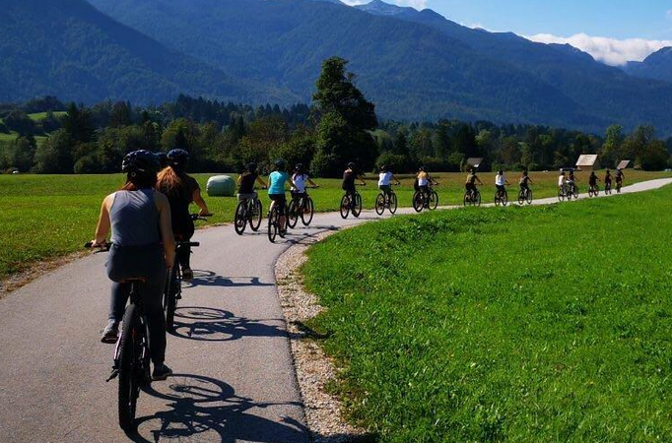
III. GIMNAZIJA MARIBOR (Maribor, Slovenia)
School projects
Our school‘s climate project is related with:
Ekošola national project
school projects like:
Healthy nutrition,
Running for health
Outdoor classrooms
Rose garden
energy remediation of the school

Slide 10
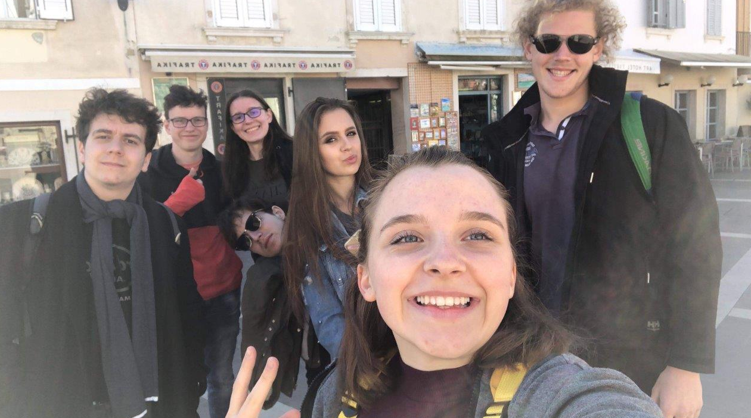
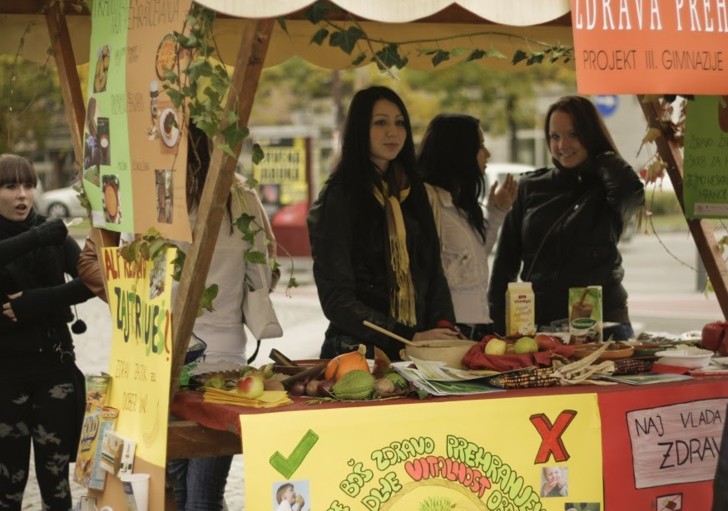
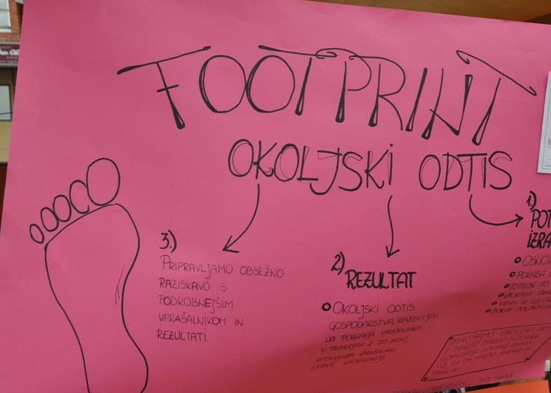
III. GIMNAZIJA MARIBOR (Maribor, Slovenia) http://www.tretja.si
Our expectations
From our participation in the Three4Climate project, we expect :
to get in contact with other schools
to exchange ideas and examples of good practice
to create a common base of ideas on how to live with zero CO₂ emissions
related action among our students

Slide 11
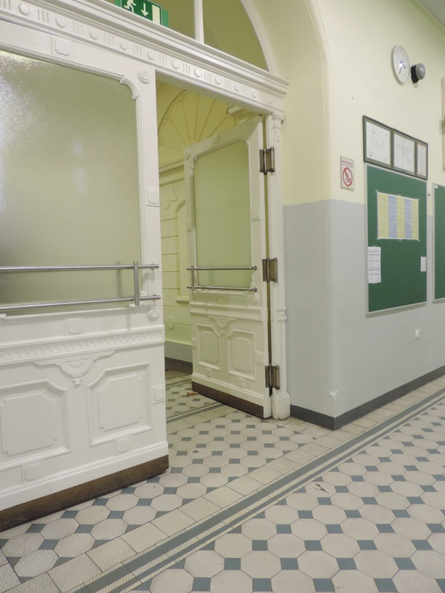
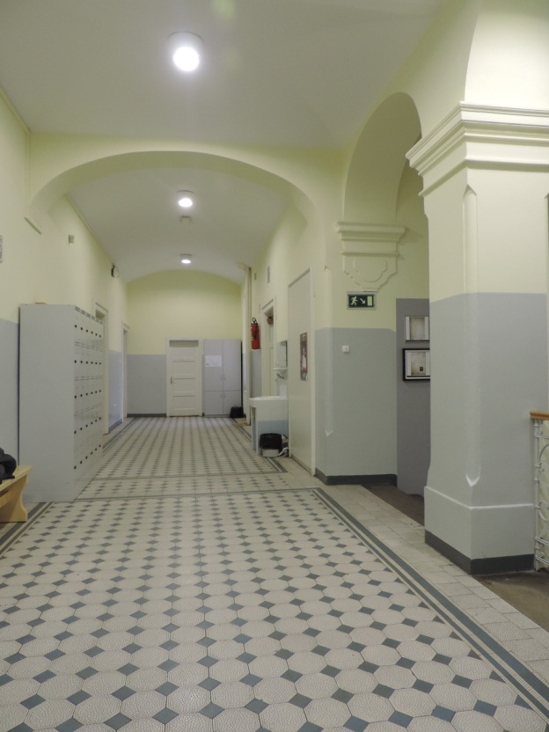
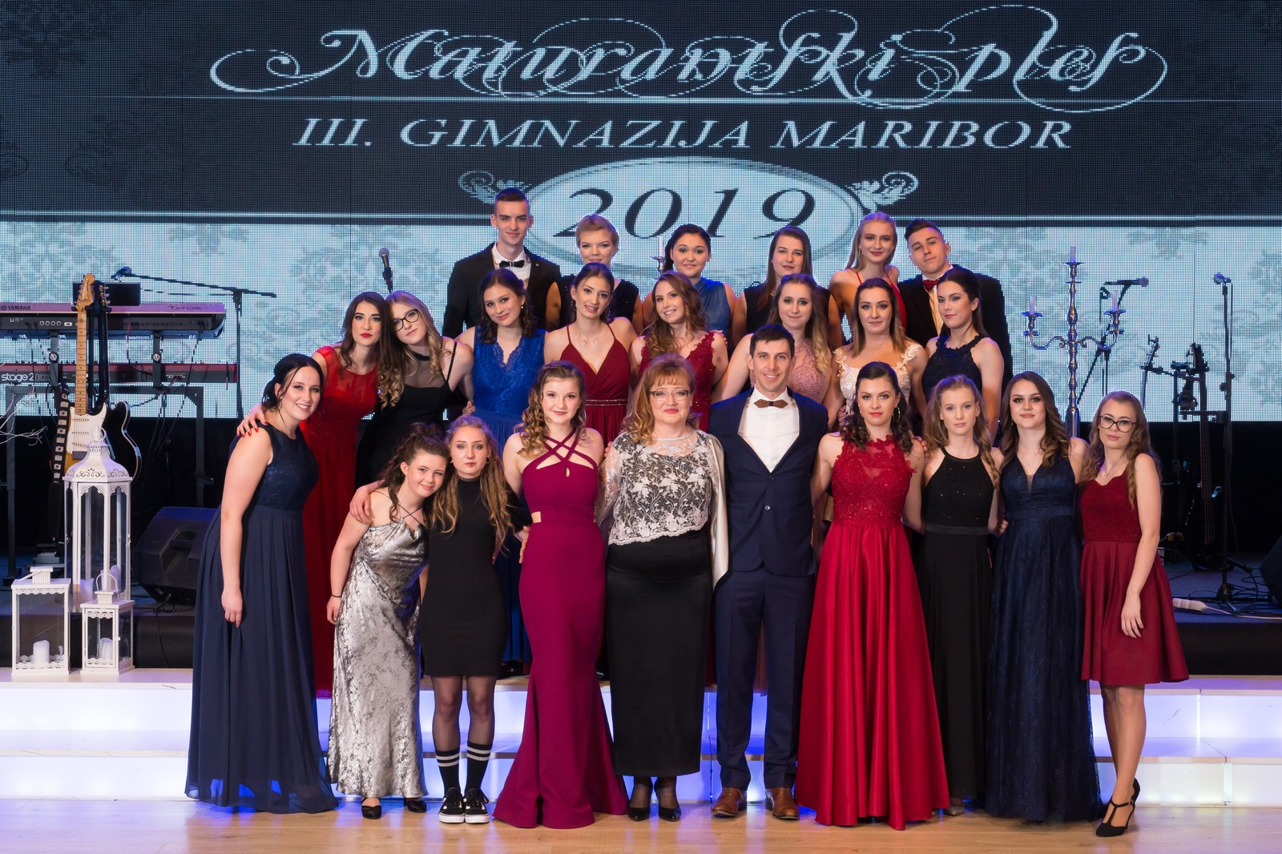
Non scholae, sed vitae discimus.
"Not for school, for life we learn."

